Slide 1

Malignant Comments Classifier Project
Submitted By: Rahul Singh

Slide 2
Introduction:
Malignant Comments Classifier Model Project includes the details about the proliferation of social media which enables people to express their opinions widely online using there comments.
Micro Credit model is used to predict the various comments given by people on the social media platform is Malignant or not.
The model is build by working on multiple models and finalizing the one best model after working on data.
For building the model performing data cleaning, EDA, data preprocessing, model building and saving the model.

Slide 3
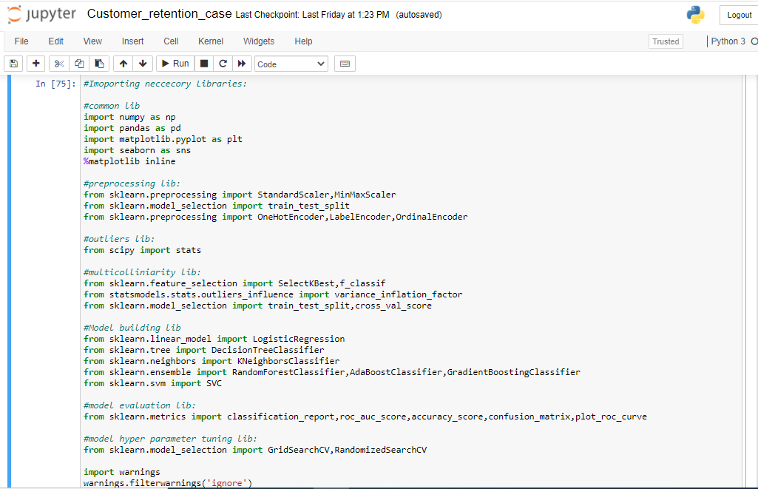
Importing Libraries:
Importing the Libraries used for EDA, data preprocessing and model building.

Slide 4
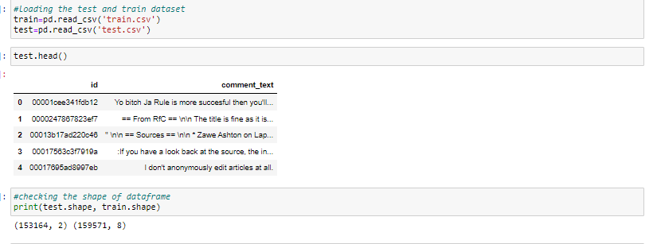
Fetching the Data frame:
Using the pandas library to import the data(train and test) from excel file to data frame.
The library has been used read_csv.

Slide 5
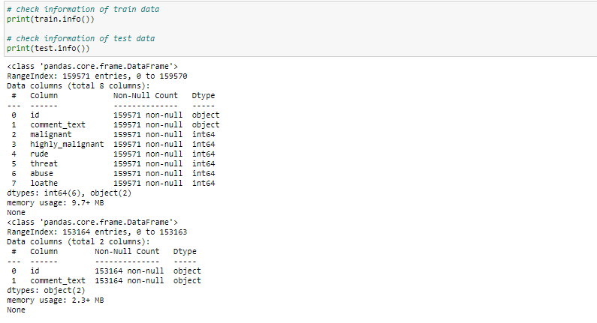
Checking the Shape and info of Data Frame:
Checking the shape of the Data frame using the .shape method.
The shape of the given train and test data frame is (153164,8) and (153164,2)
Checking the datatype information about the data frame using the info method.

Slide 6
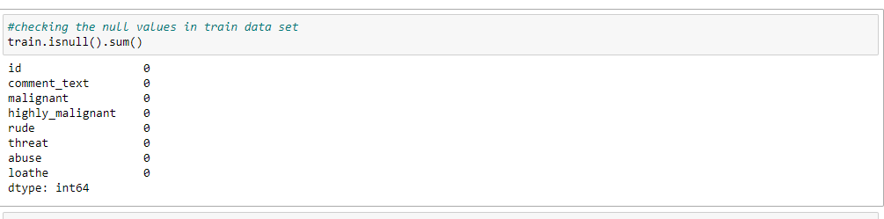
Checking the Null value count in Data frame:
Checking the null value count from every column of data frame.
Using the isnull().sum() method to check the null values. There is no null values in columns.

Slide 7
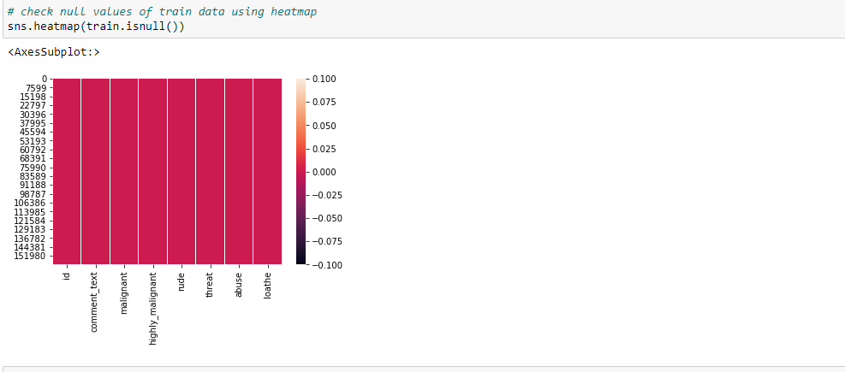
Checking the Null value using Heat map:
Checking the null value count from every column of data frame using the heat map.
Using the seaborn library and using the heat map from the library. There is no null values present in the given data frame.

Slide 8
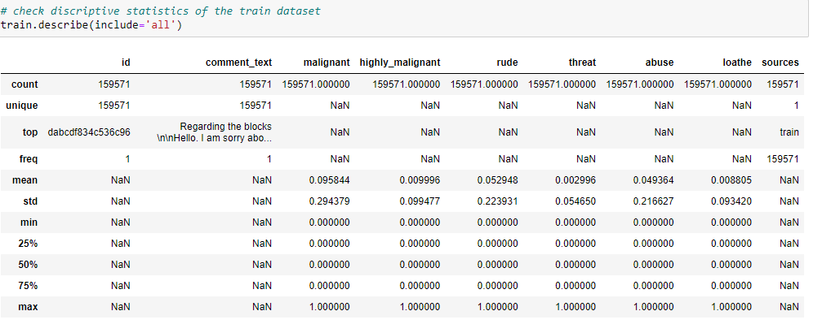
Using Describe Method to describe the data frame:
Using the describe method to describe the numerical columns.Describe method
only work on the numerical data features.
Describe is basically provide the count,mean,standered deviation,min max and quantile details of the columns data.it can be display using df.describe().

Slide 9
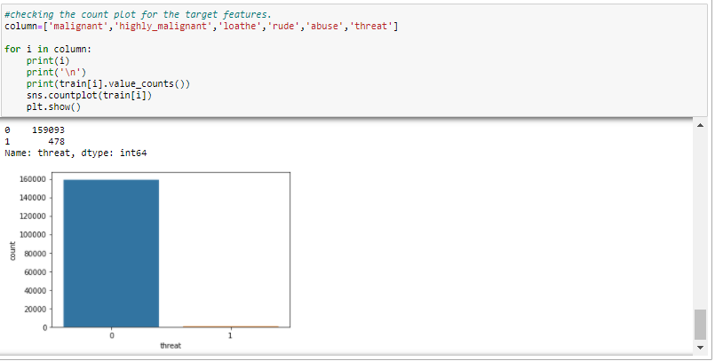
Plotting the Count Plot:
Using the count plot to plot the count ratio of every malignant comments.
The count plot shows the ratio between outcomes.

Slide 10
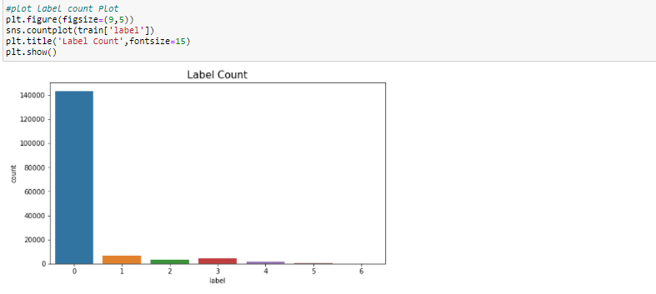
Merging all the labels to one:
Merging all the targets to the single target column for building the model.
Plotting the count plot after merging to one label.
.

Slide 11
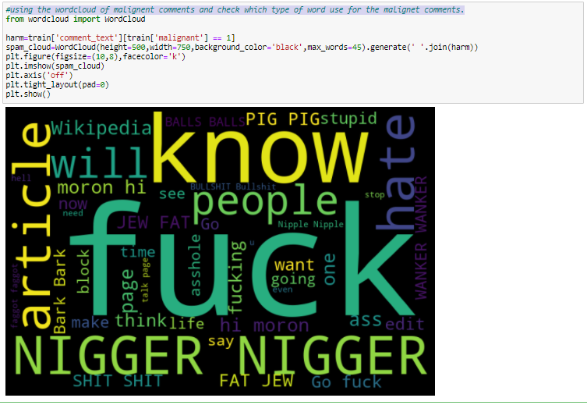
Plotting the wordcloud:
using the wordcloud of malignant comments and check which type of word use for the malignant comments.
.

Slide 12
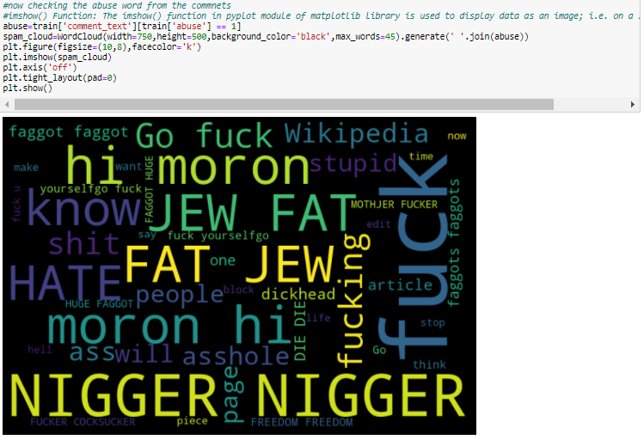
Plotting the wordcloud:
using the wordcloud of abuse comments and check which type of word use for the abuse comments.
.

Slide 13
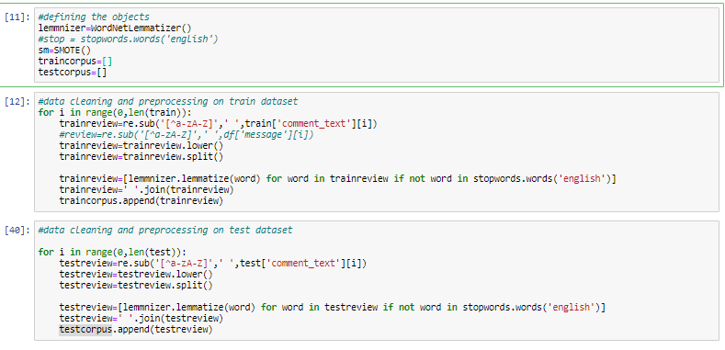
Using WordNetLemmatizer and stopwords to clean the text comment data:
The feature only contains the text comment which needs to filter and convert into the vectors for the model building.
Using WordNetLemmatizer and stopwords to fliter the text comments so the data should be converted in vectors.

Slide 14
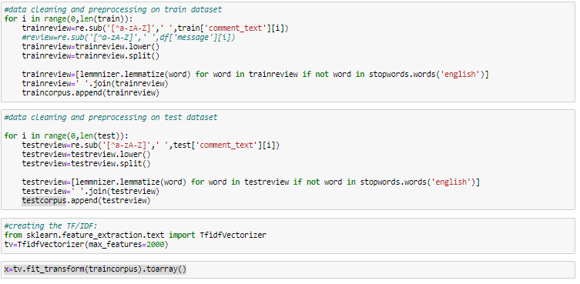
Converting words in to vectors:
Using the TF-IDF method to convert the filtered word into the vectors so after conversion features is ready for the model building.
TF_IDF method is basically read the words and convert it into sequence pattern in the numeric.
Max_features has been used to restrict the

Slide 15
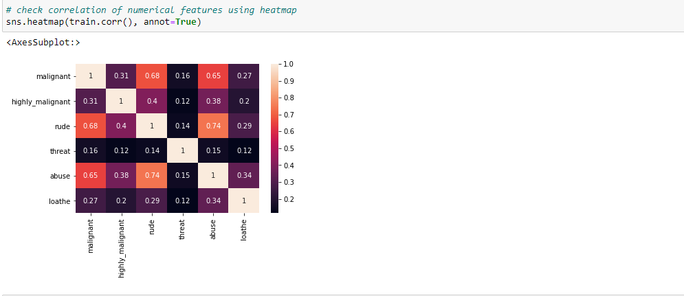
Checking Multicolliniarity Using Heat map:
Multicolliniarity is a problem for a model building.it shows relation between feature to feature. If the score is high then the features are highly collinear to each other.
Checking the multicolliniarity problem using heat map.

Slide 16
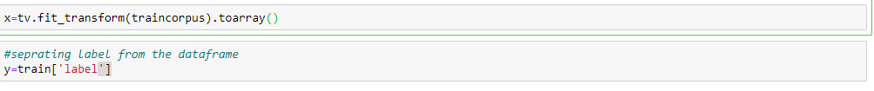
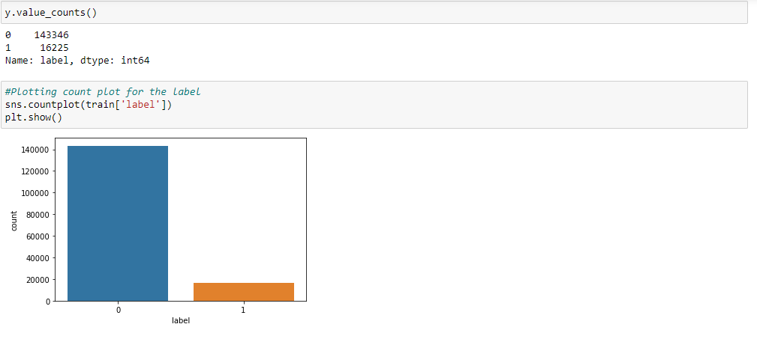
Separating the feature and target to build the model:
Separating the target and features variable in x and y variable to build the model.
It is a classification model as target variable having only two outcomes.

Slide 17
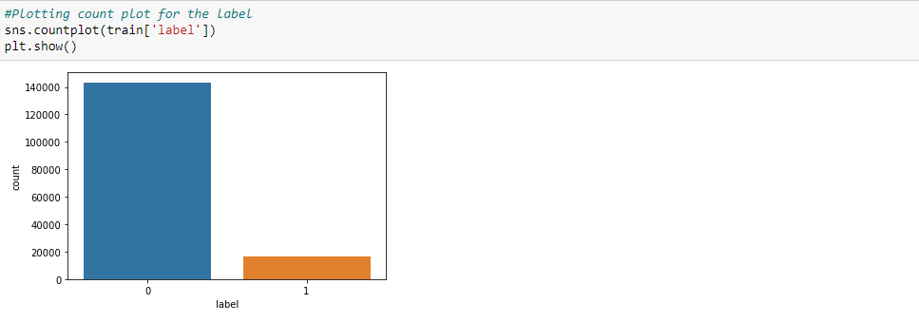
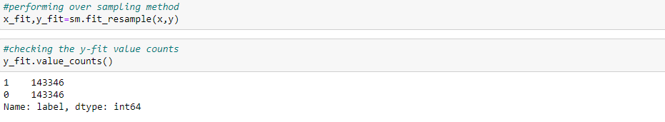
Checking Class imbalanced:
Class imbalanced issue occurs in classification model if the target variable having the imbalanced data.
Model having the class imbalanced issue so performing the up sampling to solve the class imbalanced issue.
Up sampling can be performed using the SMOTE.
.

Slide 18
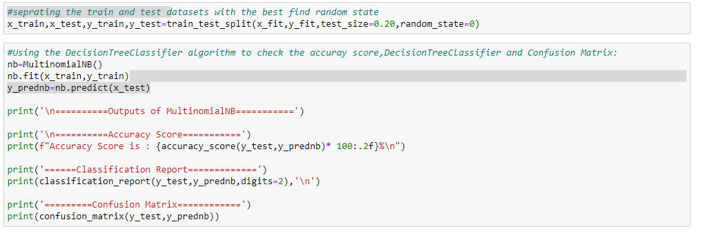
Training the model Using Train Test Split:
After the EDA and data preprocessing training the model using the train test split method.
The training the model into x_train, y_train, x_test and y_test.
Using the train test split training getting the x_train and y_train and fitting the model.

Slide 19
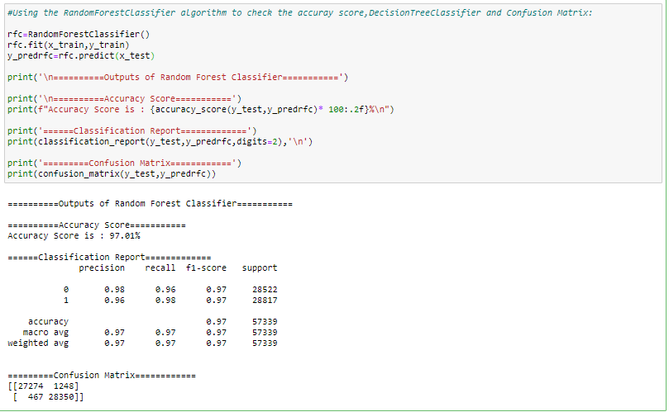
Building the multiple Models:
After the test_train_split, building the model using the test data.
Building all the classification models like MultinomialNB ,, AdaBoostClassifier, RandomForestClassifier.
Training all the classification on train and test data and finding the accuracy.

Slide 20
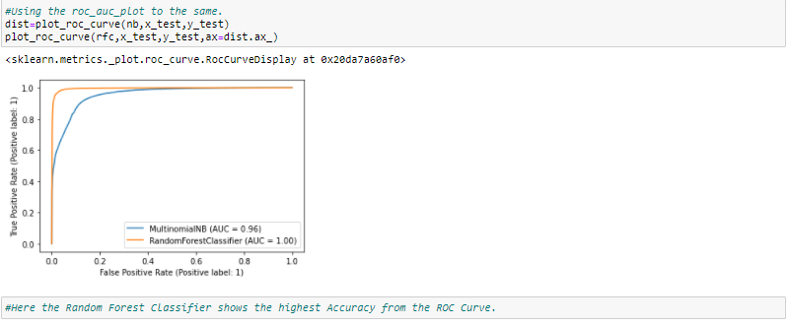
Plotting ROC AUC Curve:
Plotting the ROC AUC Curve for all the model to select the best model for the hyper parameter tuning.
From the ROC AUC Curve , Random forest classifier show the max curve.

Slide 21
Performing Cross validation score:
Cross validation and hyper parameter tuning has not been done due to the large dataset as it will take the multiple hours and still sometime shows the memory error.

Slide 22
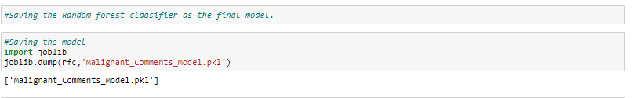
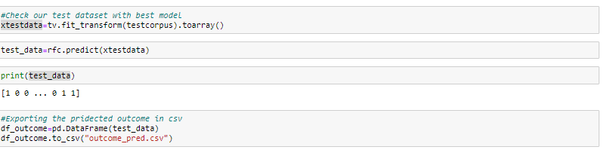
Saving the Model:
After the model building saving the final model in the pkl file.
Saving the test result output in csv file after the preprocessing.
This complete the model building.

